Slide 1
Final Results
Eshani Patel

Slide 2
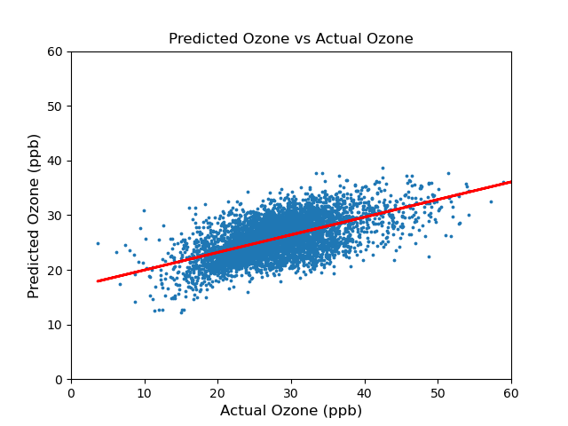
AQ-Bench:
Root Mean Squared Error = 5.6133
r correlation = 0.5887

Slide 3
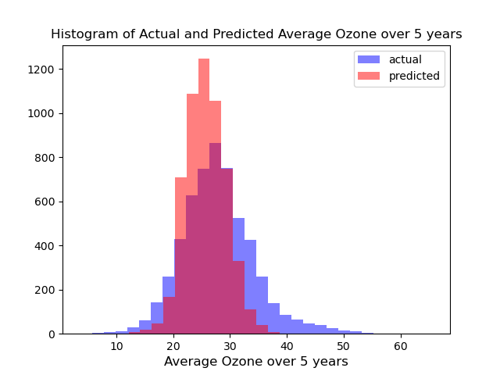

Slide 4
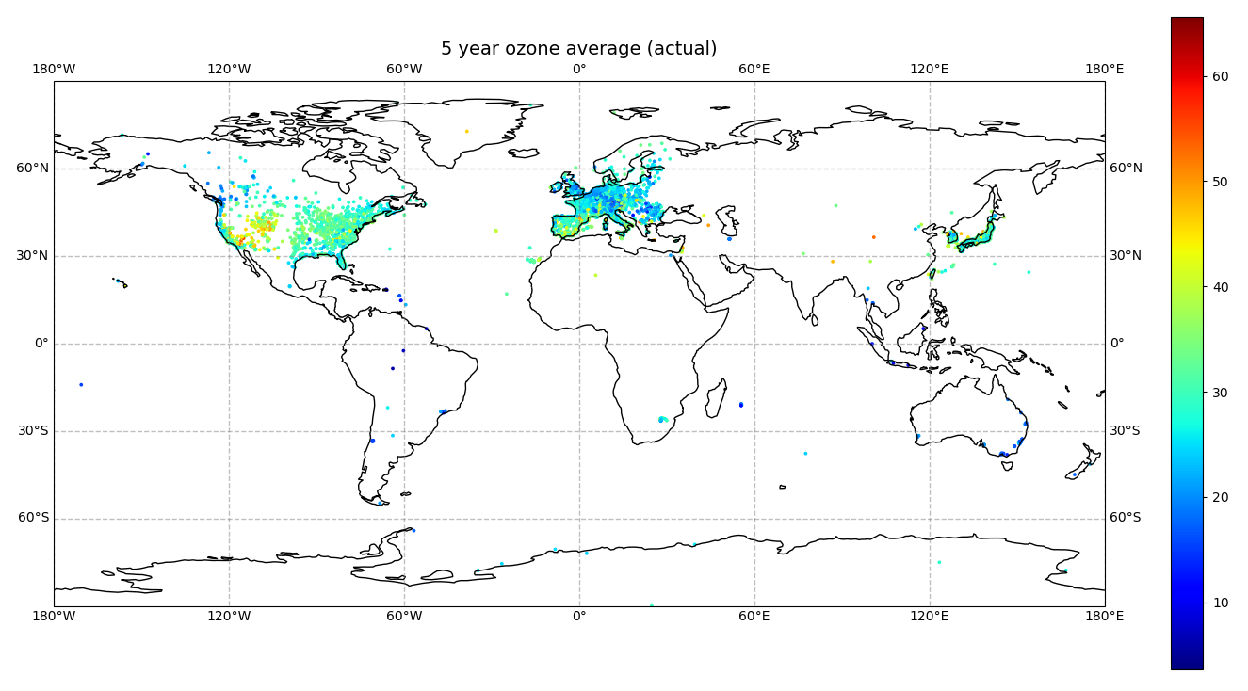

Slide 5
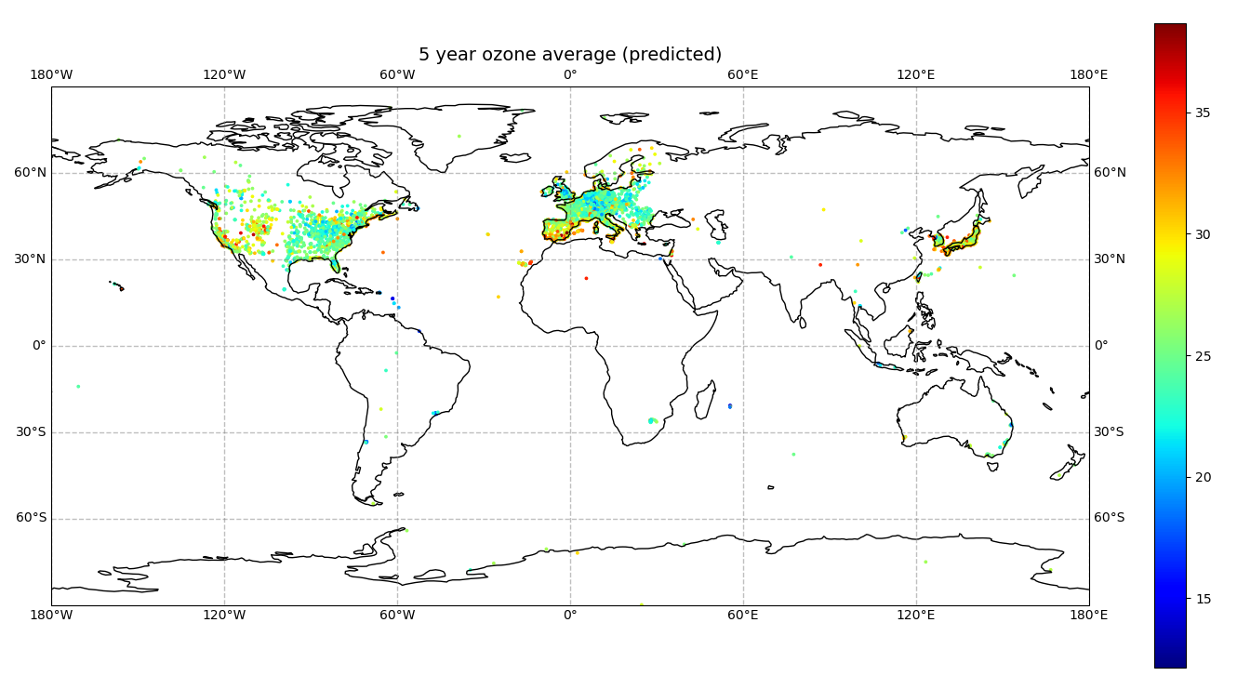

Slide 6
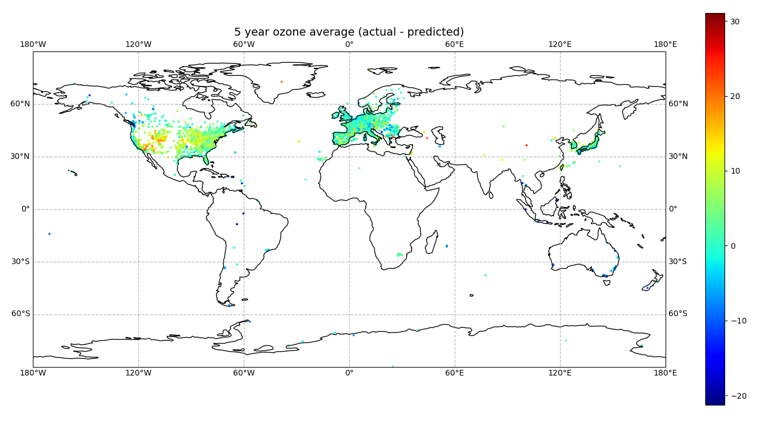

Slide 7
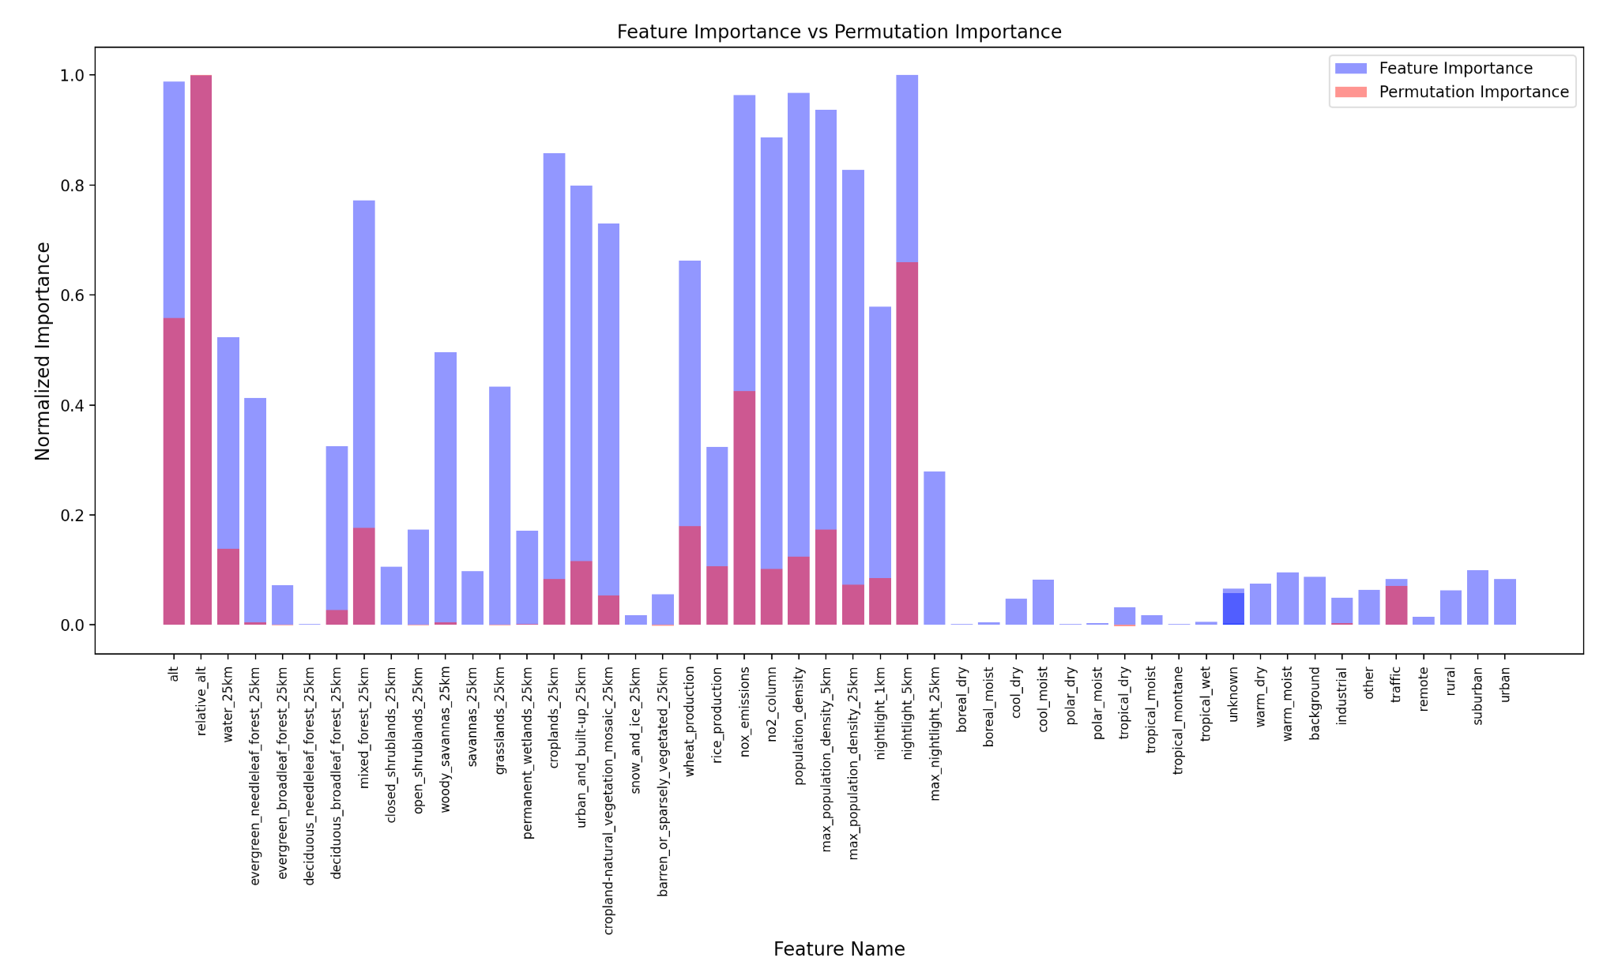

Slide 8
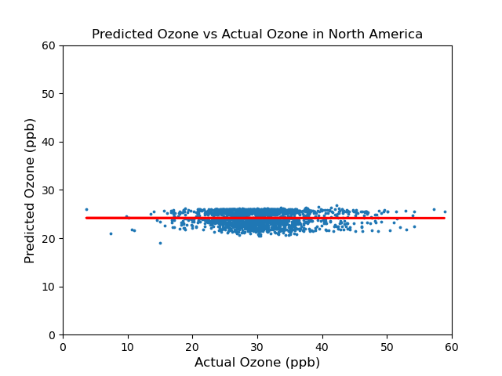
North America:
Root Mean Squared Error = 9.1461
r correlation = -0.0020

Slide 9
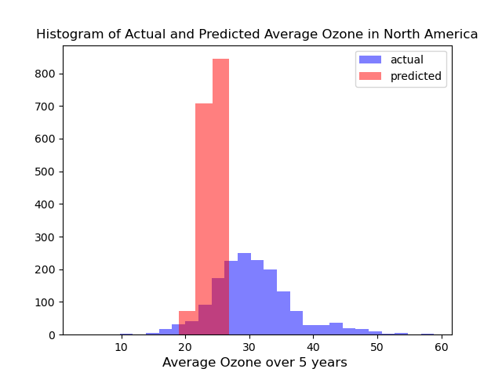

Slide 10
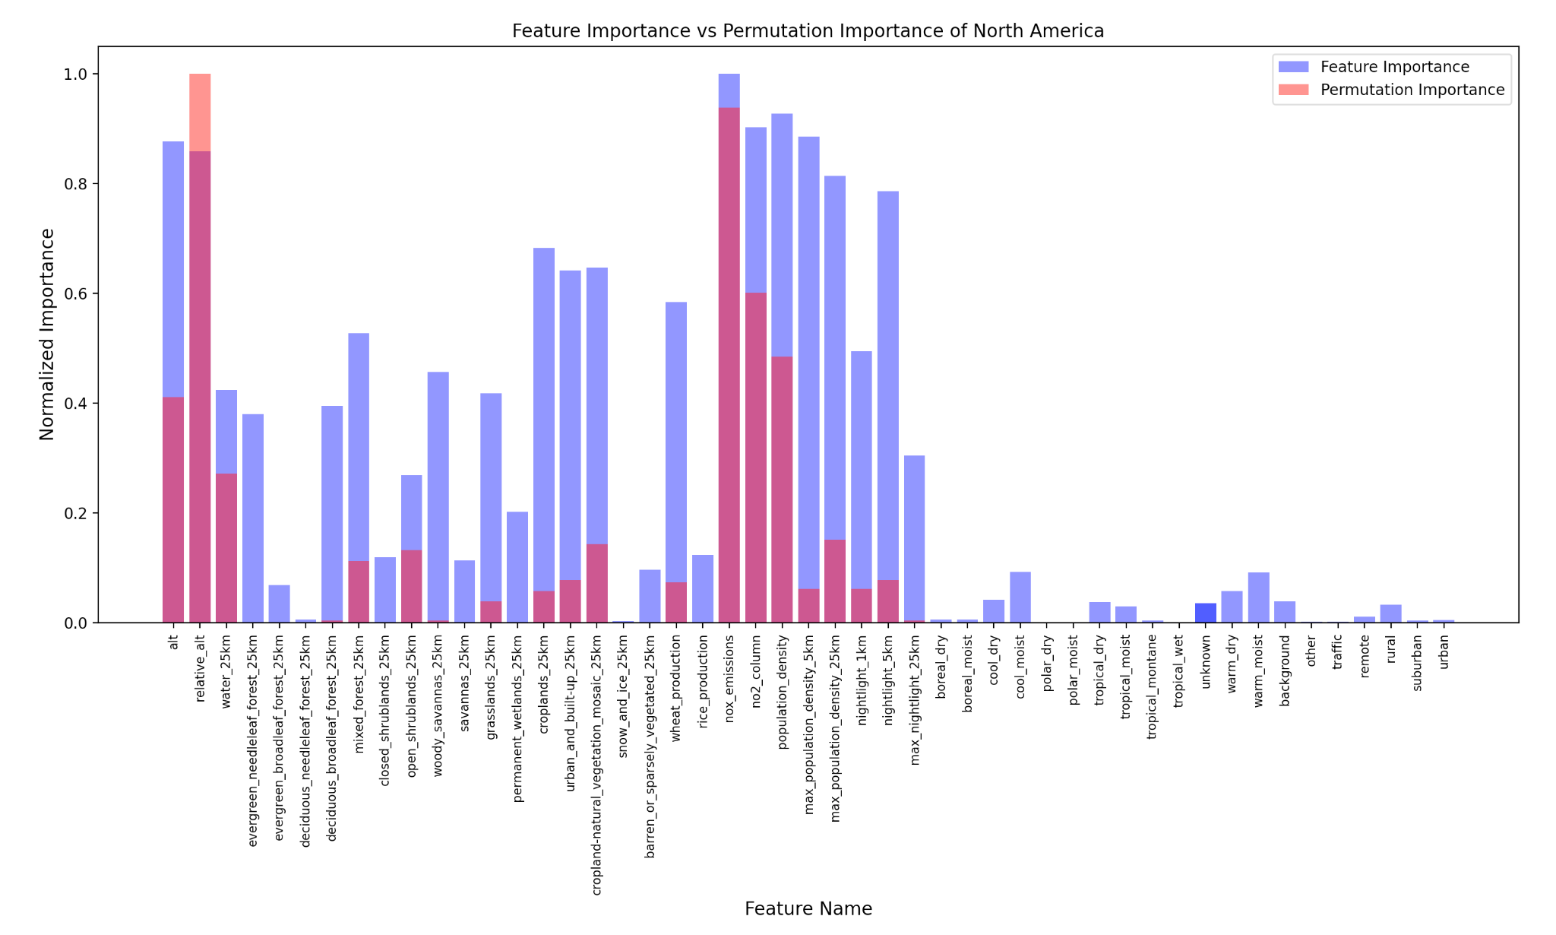

Slide 11
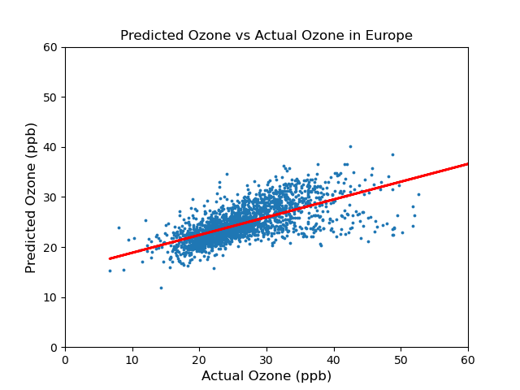
Europe:
Root Mean Squared Error = 5.1867
r correlation = 0.6612

Slide 12
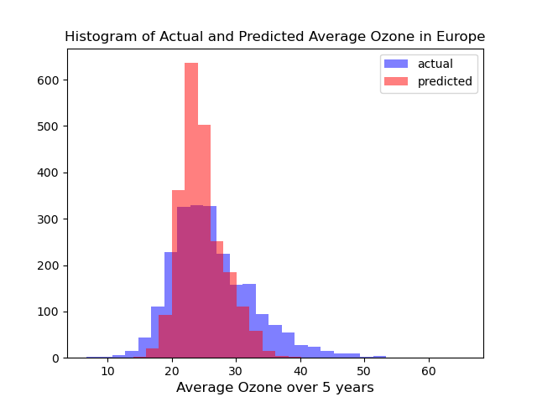

Slide 13
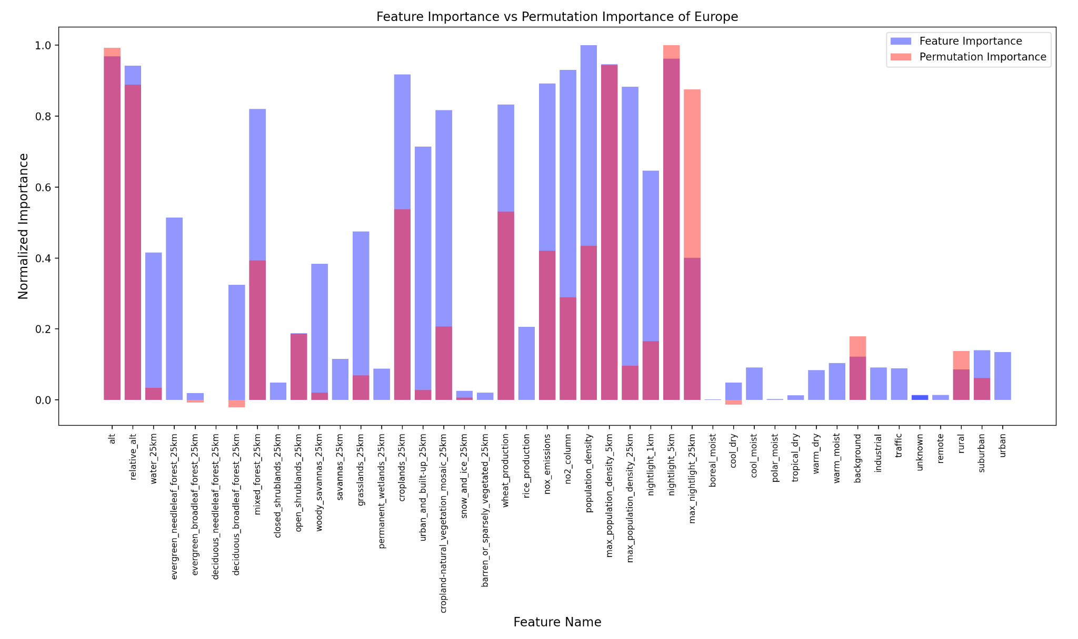

Slide 14
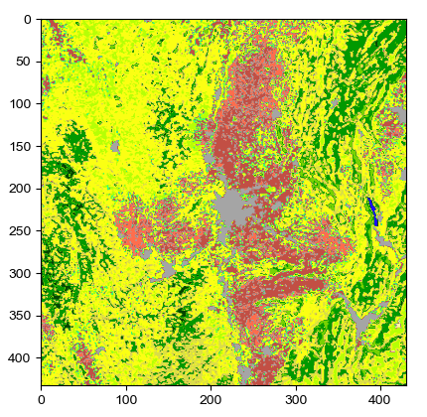
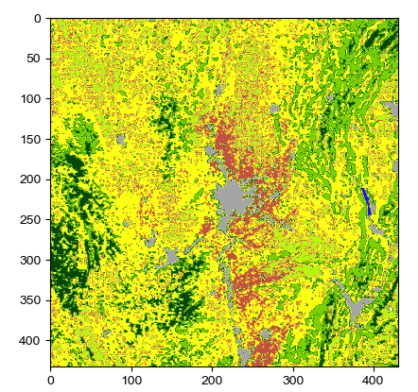
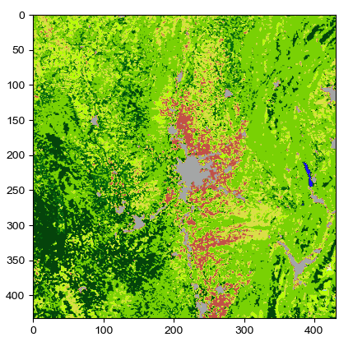
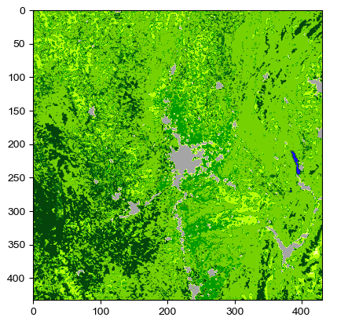

Slide 15
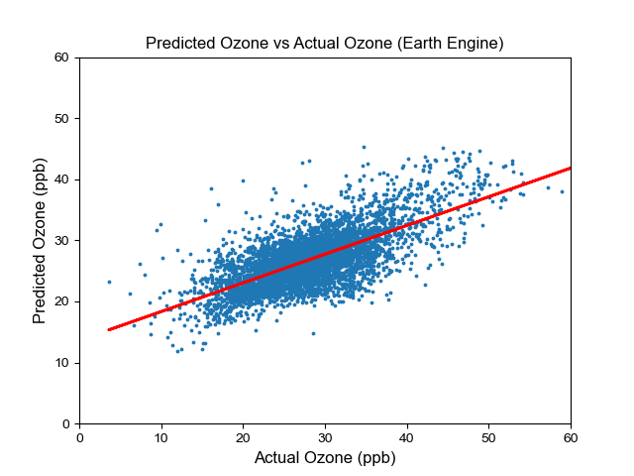
AQ-Bench:
Root Mean Squared Error = 5.6133
r correlation = 0.5887
EE:
Root Mean Squared Error = 4.7584
r correlation = 0.6925

Slide 16
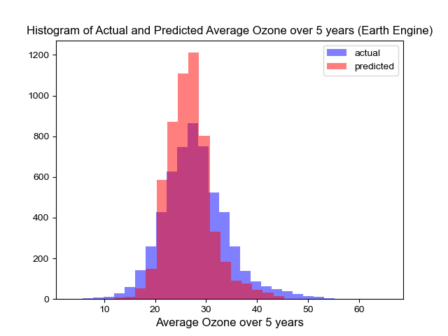

Slide 17
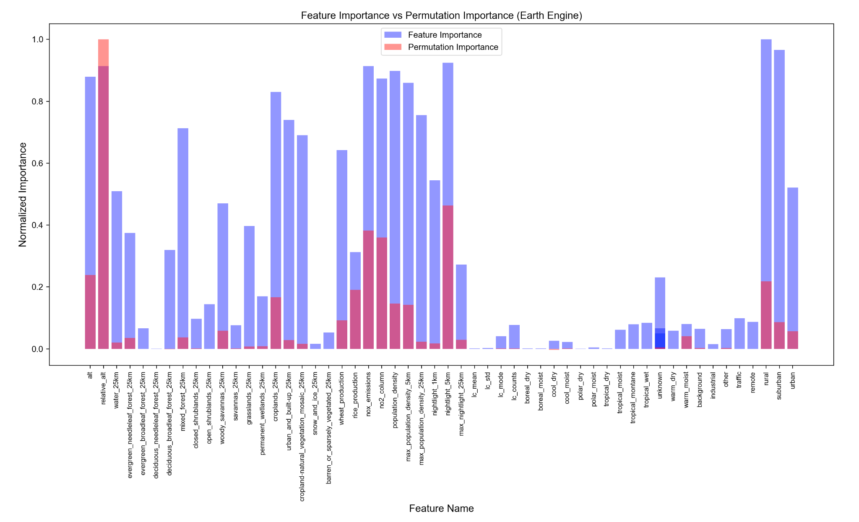

Slide 18
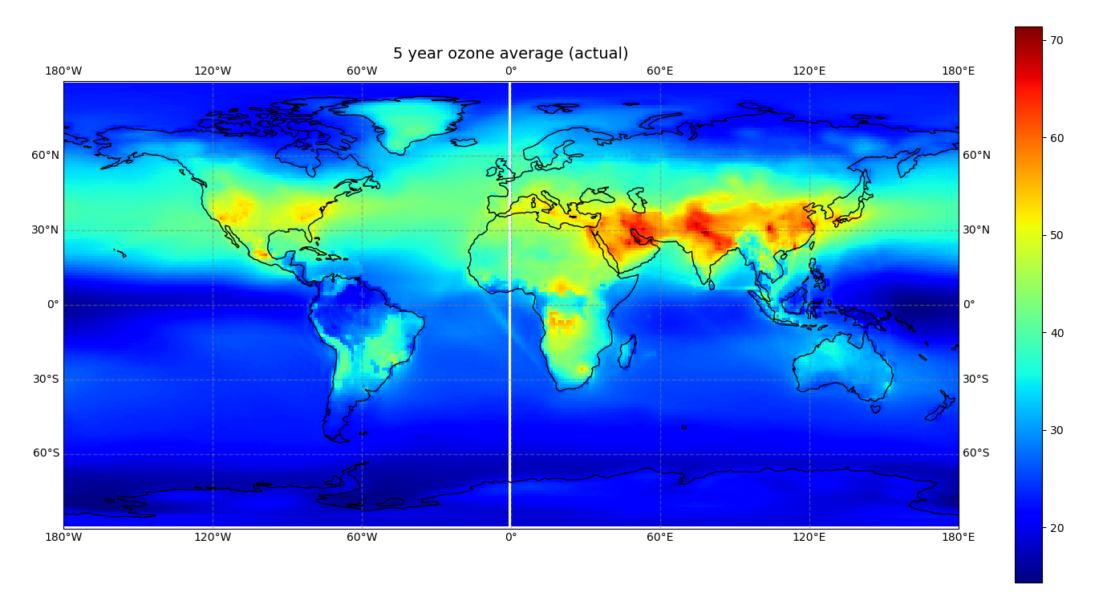

Slide 19
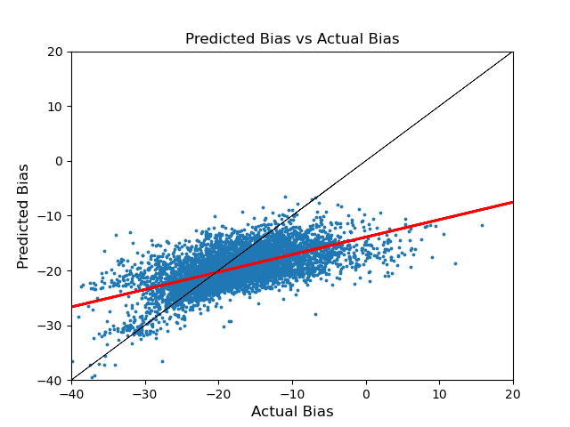
Momo Bias:
Root Mean Squared Error = 6.0414
r correlation = 0.6163

Slide 20
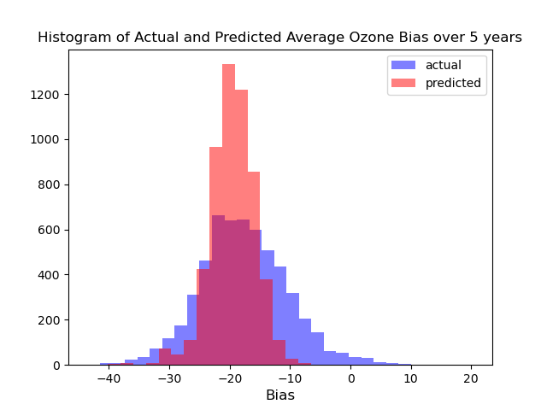

Slide 21
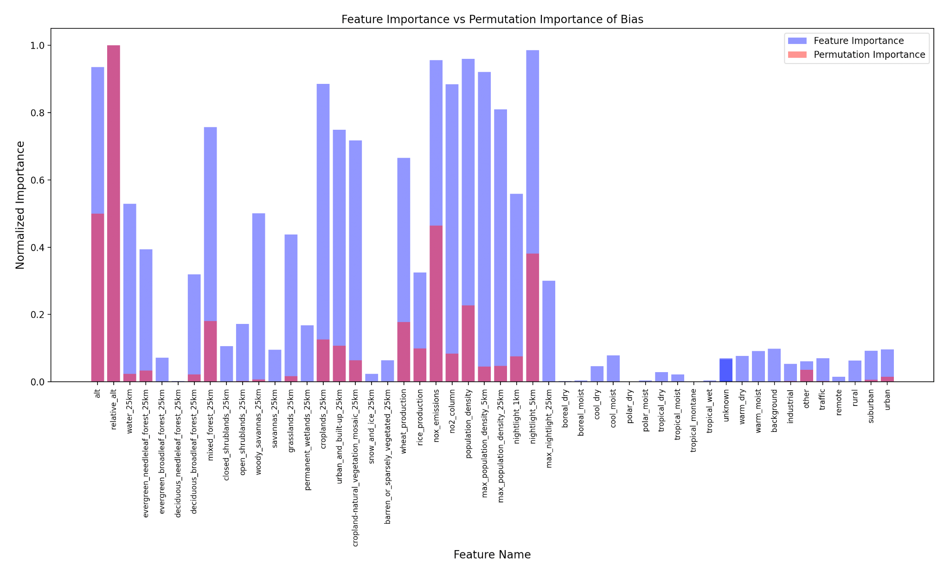

Slide 22
